Slide 1

Basic CVT Transmission
Group - 1

Slide 2
Types Of Transmission
Manual
Dual
The CVT uses two pulleys between which a steel belt runs. To continuously change its gear ratio, the CVT simultaneously adjusts the diameter of the “drive pulley” which transmits torque from the engine, and the “drive pulley” which transfers torque to the wheels.
It is a multi-speed transmission utilized in vehicles that do not require any driver to change forward gears under normal driving situations. It is consists of a planetary gearset, hydraulic controls, and a torque converter.
This transmission employs two separate clutches for odd and even gear sets which allow for especially quick shifts. The design is often similar to two separate manual transmissions, in that their respective clutches are within a housing, and operate as a single unit.
A manual transmission is a system that requires the driver to manually select a gear by operating a gear stick and clutch to change gears. This transmission system is consists of a set of gears (different sizes) along with a pair of shafts.
.
Continuous Variable
Automatic

Slide 3

It’s clutch-less transmission.
It provides smooth shift.
Wear is least.
Cons
Pros
There is significant belt wear.
A more complex braking system is required.

Slide 4
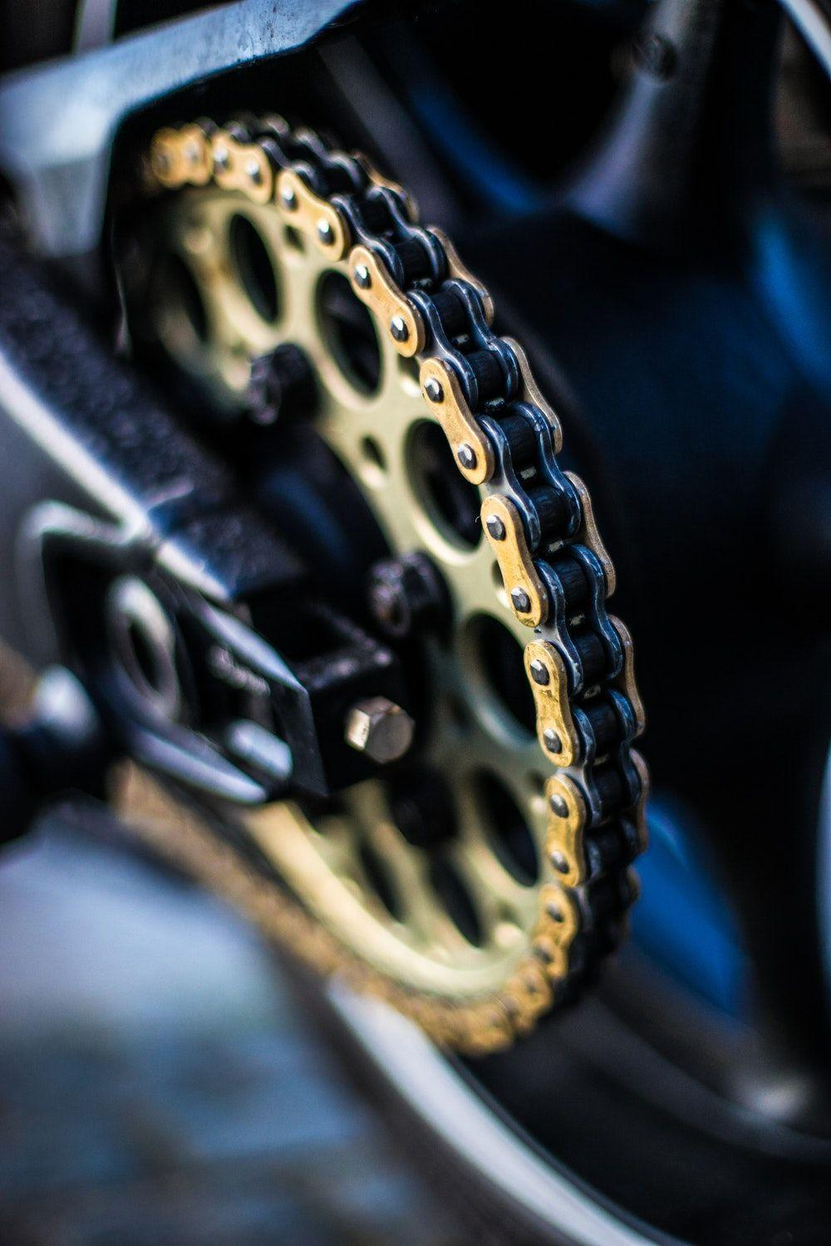
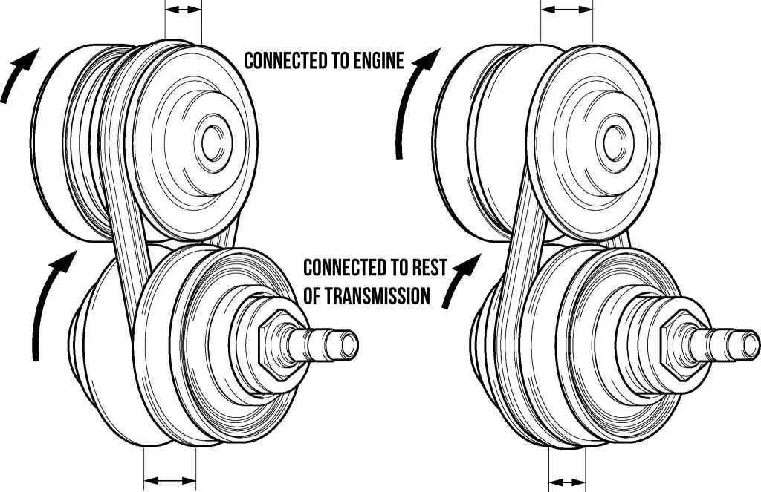
Working
A CVT uses a pulley and belt system to change the vehicle’s drive-wheel speed and torque in relation to engine speed and torque so as to provide an unlimited range of gear ratios. It is different from the automatic transmission which has a set number of gear ratios. A CVT uses components such as a high density rubber/metal belt, a driving pulley actuated by a hydraulic cylinder, a mechanical torque-sensing driving pulley, sensors and microprocessors to perform its function.

Slide 5
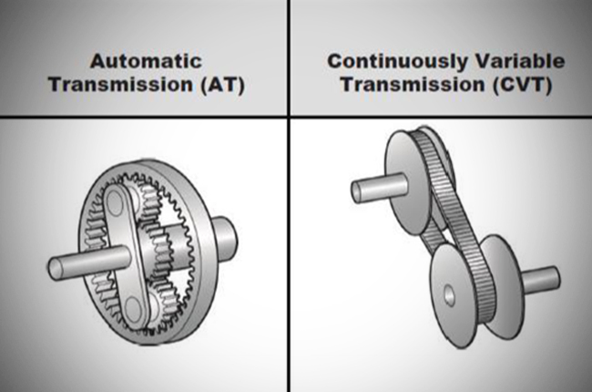
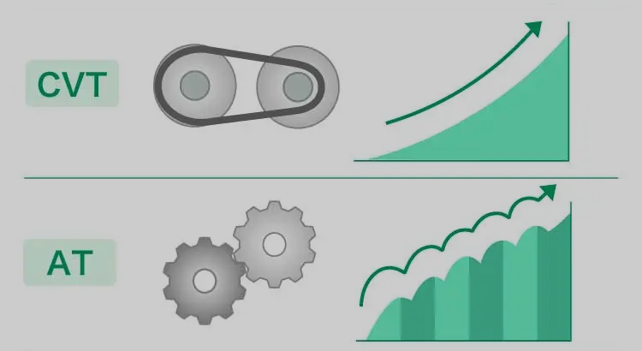
Distinction Between CVT and std. AT

Slide 6
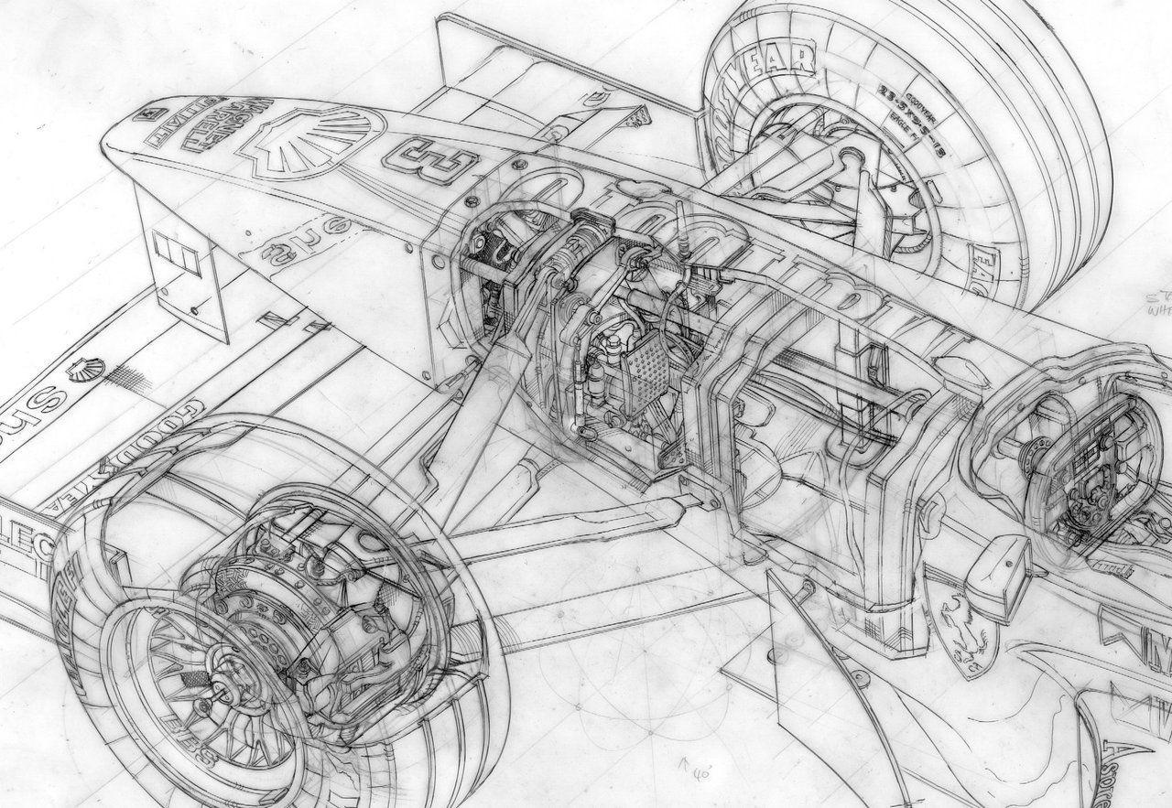
RPM & Torque
Torque ratios
when a vehicle needs high torque ratios the feeding input conical pulley (sheave) over the input shaft moves away from the fixed pulley which in turn shift part of the v-belt wrapped over the input pulleys towards the lower cross-sectional part of the conical pulley.
Speed Ratios
When the vehicle needs speed ratios, the feeding conical pulley (sheave) over the input shaft moves towards the fixed pulley which in turn shifts the part of V-shaped belt wrapped over the input pulleys towards the greater cross-sectional part of the conical input pulleys.

